Slide 1


2 Peter 1:5-11

Slide 2
Growing in Holiness
in Light of the Promised Blessed Hope of the Lord and Savior’s Soon Return

Slide 3
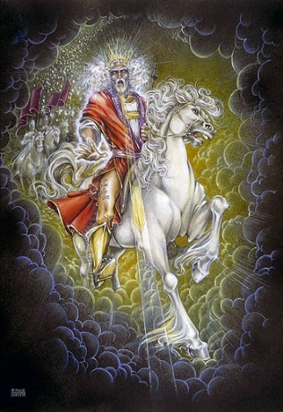
Growing in Holiness
2 PETER
The Blessed Hope is the certainty that our God and Savior Jesus Christ is retuning soon, just as He promised before the Day of the Lord, and at the end the world is going to burn (3:10). In light of this Peter tells us how we should then live.
Notes:
The message of Second Peter is about hope.
Peter tells us to put our hope in Christ, to live in the expectation of the prophetic promises of Jesus’ soon return to establish His glorious kingdom on earth until the conclusion of all things, and then at that time He will create an new heaven and new earth in which only righteousness will exists.
The more we are rooted in this promise and hope, the more we ought to live in holiness, adding good moral conduct to our faith, persevering in the midst of personal trials, and developing our Christian character all in the expectation of being rewarded with a rich entrance to Jesus’ future kingdom.

Slide 4

Growing in Holiness
2 PETER
Key Verse:
“Therefore, since all these things will be dissolved, what manner of persons ought you to be in holy conduct and godliness” (2 Peter 3:11)

Slide 5

Growing in Holiness
2 PETER
A Verse of Hope:
“Nevertheless we, according to His promise, look for new heavens and a new earth in which righteousness dwell” (2 Peter 3:13)
Notes:
Peter does not preach a pessimistic message of doom and gloom, but just as Isaiah teaches a hope out of darkness, from doom to bloom. So listen, learn and live.

Slide 6

Growing in Holiness
2 PETER
The Prologue of the Letter – 1:3-11
The Basis of Holiness – 1:3-4
Notes:
Peter as a good shepherd is concerned about the moral character of his flock and the dangers that threaten them. He first reminds them of the basis of their holiness, the gracious provision of power and promises that God has provided for their growth in holiness (vs. 3-4) which are the foundational reason why we should follow through and add to our faith.

Slide 7

Growing in Holiness
2 PETER
The Prologue of the Letter – 1:3-11
The Basis of Holiness – 1:3-4
PARTAKE
POWER
PROMISE
KNOWLEDGE BASED FATIH
GOD’S GLORY AND VIRTUE
Notes:
Everything begins with God’s Person, His glory, moral excellence and love for us. It is because of God’s is love that He loved the world and sent His Son as the provision for our salvation. Our faith is based in the knowledge of Christ’s person and provision and proclamation. It is by the means of faith in Christ and His provision that was proclaimed to us, that we received eternal life.
And when we come to know Christ by faith, it is by this means that we are now made recipients of a spiritual equipping and empowering. It is knowledge based faith in Christ that is the means by which we can access God’s power and promises,
It is God’s divine power that has sufficiently gifted us with all things related to life and godliness. Born-again believers have all that they could possible need to live a godly life. Nothing else is needed. Faith alone in Christ alone for eternal life. Divine power alone for life and godliness.
God has also given us “exceedingly great and precious promises.” God has given us the promise of eternal life. Peter has had previously written about promises related to a believer’s inheritance (1 Peter 1:3-5). The promises that Peter has most in mind are the promises that God has given us in order that we live godly in this life. And these promises are also the means by which we can become partakers of God’s nature.
What promises are these? At the very least, they must be the prophetic promises so strongly emphasized in this letter, which Peter had previously made know to them concerning the power and the coming of the Lord Jesus Christ (1:16) It is the promise of His physical coming to the the physical earth (3:4, 9, 13) and all of the accompanying promises related to His promised return, including the promise to “wipe away every tear from their eyes; there shall be no more death, nor sorrow, nor crying. There shall be no more pain, for the former things have passed.” (Rev. 21:4) And especially Peter has in mind the promise of a new heaven and earth in which only righteousness dwells, that is, no more sin.
One of the great lessons of second Peter is that to maintain a holy life in a corrupt world like ours, we must be deeply rooted in the prophetic promises of God’s word. We must hold fast/stand to the “blessed hope” of the return of our Lord and Savior Jesus Christ. Failing to do so only leads to an absence of readiness.
The promise of His return has are extremely valuable and importance reliance to our growing in holiness. What we believe concerning His coming has great implications for our life now and in the future.
It is through these very great and valuable promises that we discover God’s purpose in given them, so that we can “participate”, “become partners” or “sharers” in God’s nature. God’s gift of divine power and promises are the means by which we can partake in His divine nature and work.

Slide 8
Growing in Holiness
2 PETER
LOVE
BRO. KINDNESS
GODLINESS
The Characteristics
of Holiness – 1:5-7
PERSEVERANCE
SELF CONTROL
KNOWLEDGE
VIRTUE
FAITH
Notes:
But we need to know what that divine nature looks like, so Peter gives us the characteristics of holiness, telling us to diligent to add to our faith.

Slide 9
Growing in Holiness
2 PETER
LOVE
“For if these things are yours and abound, you will be neither barren nor unfruitful in the knowledge of our Lord Jesus Christ. (1:8)
BRO. KINDNESS
GODLINESS
PERSEVERANCE
SELF CONTROL
KNOWLEDGE
VIRTUE
FAITH
Notes:
And if we add or apply these characteristics to our lives we will become ever increase fruitful and productive in favor and knowledge of our Lord Jesus Christ.

Slide 10
Growing in Holiness
2 PETER
LOVE
“For he who lacks these things is shortsighted, even to blindness, and has forgotten that he has been cleansed from his old sins.” (1:9)
BRO. KINDNESS
GODLINESS
PERSEVERANCE
SELF CONTROL
KNOWLEDGE
VIRTUE
FAITH
Notes:
Peter adds that he who lacks these things is shortsighted and blind, forgetting that he was saved.
Shortsighted (“nearsighted”) people cannot see very far in front of themselves. In other words, they only see things that are up close.
What does Peter have in mind? The epistle as a whole lays heavy stress on the reality and certainty of the Lord’s coming in the distance future. He is encouraging us to be farsighted, keeping our focus on the Coming of the Lord which occurs in the future. Ideally we want to maintain 20/20 vision, have a balanced look to the immediate things and to future things.
Unfortunately, there are many, including the deceiver himself, who wants to get our eyes off the future and give all our attention the immediate, “the now crowd”. There are many “shortsighted/nearsighted” false teachers that Peter, as a good shepherd, must warn his flock concerning the coming of our Lord.

Slide 11
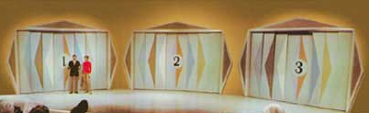
Second Coming
2 PETER
Let’s Make A Deal
Notes:
In order to better explain todays more modern and more sophisticated “shortsighted” beliefs concerning the Second Coming of Christ and the related events surrounding it, we are going to spinoff on a popular game show “Lets’ Make a Deal” [Monte Hall]. Instead we are going to play “Let’s Make a Choice”… But this is no game, this is real life, with real life consequences to what we believe, for the present and the future.

Slide 12
Second Coming
2 PETER
Let’s Make A Choice
Notes:
Instead we are going to play “Let’s Make a Choice”… But this is no game, this is real life, with real life consequences to what we believe, for the present and the future.

Slide 13
Second Coming
2 PETER
“this generation?”
Past
Present
Future
Preterits
Historicist
Futurist
“Already”
“Now”
“Not Yet”
Notes:
We are going to focus on the phrase “this generation” – When Jesus said, “this generation will by no means pass away till all these things take place.” (Mt. 24:34) which generation was He referring too? There are three major options from which to chose from, either He’s referring to a past generation, or a present generation, or a future generation. The past option is called the “Preterits” view, sometimes called [Over]”Realized Eschatology”, the present option is called the “Historicist” view, and the future option is called the “Futurist” view. Another way of describing it is “already”, “now” and “not yet”. And then to complicate things even more there are is an overlap of some of these views, such as “Progressive Dispensationalism” – “already, not yet” which is not really dispensation at all, but I’m not going to get into all that today.

Slide 14

Second Coming
2 PETER
“this generation?”
Past
Full Preterism
Preterits
Partial Preterism
Detail concerning the 2nd Coming are Unknown
Notes:
Preterism teaches either all (Full Preterism) or a almost all (Partial Preterism) that the events described in the Olivet Discourse including Revelation came to pass by AD 70, with the destruction of the temple, and the persecution of Christians under Emperor Nero who was the antichrist, the 666. Some partial Preterits believe though some events were not fulfilled until the fall of Rome in AD 411. They identify “Babylon the Great” with the Roman Empire.
Full preterists believe the destruction of Jerusalem fulfilled all eschatological or “end time” events, including the resurrection of the dead, Jesus’ Second Coming or Parousia, and the final judgment. They only believe in a “spiritual coming of Christ” in AD 70. This makes them equivalent to the false teachers that Peter is going to describe in the next chapter, who deny the physical return of Christ to the earth. They are “shortsighted” and “blind”. Even R.C. Sproul (a partial preterists) considers them to be completely heretical and anti-Christian.
Fortunately, Partial Preterits at least still believe in a future physical return of Jesus, a physical resurrection of the saints and a final judgment, though the details are completely unknown to us. It is a very good thing they believe this for if they did not they would cease to be Christian in any sense of the world. Being agnostic about the real future is simply a reflection of the predominate worldview today, “Post-Modernism” that says we cannot know anything for certain, even if 2+2=4. They are “shortsighted” you see, but not yet completely blind.

Slide 15
Second Coming
2 PETER
“this generation?”
Past
Full Preterism
Preterits
Partial Preterism
R.C. Sproul, David Chilton
Kenneth Gentry
Reformed Presbyterian Church
Notes:
Notable Partial Preterits include R.C. Sproul, David Chilton, and Kenneth Gentry, members of the Reformed Presbyterian Church…

Slide 16
Second Coming
2 PETER
“this generation?”
Past
Full Preterism
Preterits
Partial Preterism
N.T. Wright, Retired Anglican Bishop
Richard B. Hays
United Methodist Church
Notes:
Also N.T. Wright, retired Anglican Bishop, and Richard B, Hays, a minister in the United Methodist Church.

Slide 17
Second Coming
2 PETER
“this generation?”
Past
Full Preterism
Preterits
Partial Preterism
Luis de Alcasar
A Roman Catholic Jesuit Priest
(1614) “Counter Reformation”
Notes:
A Roman Catholic Jesuit priest by the name of Luis de Alcasar is believed to have develop the first preterists system (1614) during the Counter Reformation, to refute the Historicist view held by the Reformers. The primary motive for doing so was to deflect accusations that the present pope(s) was the antichrist and that Rome was the Great Whore of Babylon, because the coming of the antichrist was something of the past, not the present. The Preterits system was originally a defense to rebut Luther and Calvin’s claim that the pope was the antichrist.

Slide 18
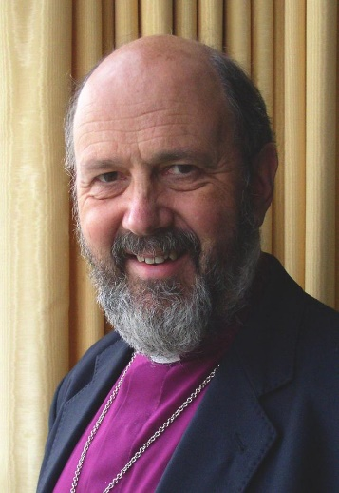
Second Coming
2 PETER
“this generation?”
Past
Full Preterism
Preterits
Partial Preterism
N.T. Wright
The Rapture is a Myth
Notes:
It’s important to know what they are teaching. N.T. Wright believes there is no such thing as a rapture. It’s a myth! – The idea of believers flying off “caught up” into the sky to meet the Lord there, is a myth. The whole pre, mid, post rapture question is irrelevant. The rapture is just a picture, an image of one of the surrounding events related to the 2nd Coming of Christ, its just figurative language. It’s not literal, but it something like literal. “It is not this, but it is something like this, or that.” It’s a metaphor, like people say we are “caught up in the moment”. What the rapture really means is that when Christ returns to the earth people will rise up and go out to meet him. That’s it.
“Preterits take the dangerous step of spiritualizing all passages of Scripture that relate to the nation of Israel, and claim that these refer to the church, the “New Israel.” They teach that the “old earth,” which Scripture says will pass away, is the Old Covenant. The new heaven and new earth, they say, is the New Covenant, and the “elements,” which Scripture says will burn with fervent heat, are the “elements of the law.”
They deny that there is going to be any cataclysmic or catastrophic future destruction of the present heaven and earth. They are the same ones who deny there ever has been a catastrophic event in the past, like a global flood, it was only a local flood, you see. All things continues just as they were since the beginning. They are the same scholars who deny the historic interpretation of the creation story. Oh, no! God did not literally create the heaven and the earth, He created it something like six days. They come dangerously closing to teaching what the false teachers teach in second Peter.
He says, “Instead of destroying the earth, God will somehow rebuild and restore the earth (though we do not know any of the details) to its original form and perfection, otherwise what’s the point of caring for the planet or its people. If all that happens is that you leave behind the world to inhabit a spiritual body and God is going to leave the world on the rubbish heap somewhere. What’s the fuss about working for justice in the present? What’s the problem over world hunger, aids, social injustices and inequalities? These are trivial and irrelevant of whether you’re going to heaven tomorrow.”
They accuse the futurist of being farsighted, that is, the Futurist are some heavenly minded they are of no earthly good. Wright makes the false assumption that the “Left Behind” crowd believes that all their concerned about is escaping the earth and going to heaven forever, leaving the world to itself. They think that the Futurist say, “Why should we straight a crooked picture on a sinking ship?” In other words, “While bother with fixing the world when its going to be destroyed.”
So what we need to be doing in the present is working to bring righteousness, justice, love and peace to the world, and then some day in the future God will look down on the earth and see what a great job the church is doing as say, “I think I’ll go down and join them”. This is what’s known as Postmillennialism--Christ returns after the millennium, after the world is made right. This was a very popular view in the late 19th century into the 20th century, when it appeared that the world was becoming a better place with all of the new inventions, technologies, and industry, the missionary movement was at its peak. But then something went terribly wrong in 1914—WWI, then WW2, Korea, Vietnam, Cold War, 1960’s, assassinations, etc. Postmillennialism went into hidden. However recently Postmillennialism and Preterism trying to make a comeback, and millions are following them.
Now, if Mr. Wright has limited his understanding of the Futurists to the “Left Behind” novels and movies then he is not as scholarly has he thinks. In a recent poll, it was discovered that only one third of Americans who believe in life after death, believe in the resurrection of the body. The whole idea that Christians simply go to heaven when they die, to inhabit a spiritual body forever, did not originate with the Futurist. In fact, it is the Full Preterits that deny a bodily existence in the future, some even deny a bodily existence of Jesus in heaven and a bodily return of Jesus.
Futurist teach Christians are raptured not to escape the earth, but to escape the wrath of God that he is going to poured out on the earth, to return with Him to the earth, to rule the earth in glorified resurrected physical bodies over those who are on the earth.
Also, Preterits make it sound like through their scholarly research, and their modern methods of interpretation, known as higher criticism, that they are part of a special group who have discovered the hidden truth, and therefore we need a new reading of the Scriptures, based on their methods. One author states, “The astonishing good news is hidden within Christ’s parables and prophecies.”
Another says (paraphrasing), “If you are weary of gloomy forecast of the future, pessimistic prophecies and anxious about the apocalypse we have the antidote with mountain of scholarship to tell you what the Bible really says about the end times and save us from the fear of cosmic catastrophes in the heavens. Just relax! Its all in the past. If it’s true, then great. If it’s not true, then many people are not going to be watching and ready when it does come.
But this is the same old hamburger. As Solomon said, “There is nothing new under the sun”. They dressed up old ideas and wrapped them in a new package. As we say in the News business, “It’s the same trash different can”.
The Preterits say that all of signs in the Olivet discourse and the book of Revelation are all in the past. If so, one blog site asked some probing questions, “So when was the Gospel preached to all the nations? When was the Mark of the Beast implemented? When did the antichrist place His statue of himself in the holy of holies? What about China’s 200-million-man army? When did 100-pound hailstones fall from the sky? When were there signs in the sun, moon and stars? And what date was it when the Euphrates River dried up?”
Jesus said this would be an unprecedented event that had never occurred before or will ever occur again. If all these catastrophic, cataclysmic, cosmic and momentous events occurred in the past, surely someone would have notice it. . Right? Why do the historians of the day not mention all these things? The blog continues, “The questions are endless. Why did we have the rebirth of the nation of Israel? If Jerusalem was forever removed from being the burdensome stone, why has it now returned to that status? When did all the Jews shout, “Blessed is he who comes in the name of the Lord,” as Jesus said they would? (Preterism, I Can’t Believe it)
The Preterits out is this, “We’re not hyper-literalist!”—”These momentous things did not actually happened, but only something like these things happened.” It’s just the imagitive language.

Slide 19
Second Coming
2 PETER
“this generation?”
Assuredly, I say to you, all these things will come upon this generation. "O Jerusalem, Jerusalem… See! Your house is left to you desolate; (Mt. 23:36-38)
“Assuredly, I say to you, this generation will by no means pass away till all these things take place.” (Mt 24:34-35)
Notes:
Jesus predicts the destruction of Jerusalem in Matthew chapter 23 and says that its destruction will occur within the lifetime of those who were living in Jerusalem at that time. No one disputes this.
The Preterits also argue that all of the events surrounding his 2nd Coming describe in chapter 24 will also take place within that same generation. In other words, all the event described are signs of the coming destruction of Jerusalem which were completed by AD 70. Therefore, everything here is describing past events.
But notice when does Jesus say “all” these things will take place—verse 34, this verse follows verse 29-31 describing the sign of the Son of Man and His coming when every eye will see Him. That is why Full Preterits believe that Jesus has already come, and this is why they call Partial Preterits, Inconsistent Preterits. As you can see and hear it can get pretty convoluted.
But here is the solution, it’s actually very simple.

Slide 20

Second Coming
2 PETER
“this generation?”
Sign of the Soon Destruction of Jers.
Luke 21:20-24
(? #1)
Sign of His Coming
Mt. 24:29-31
(? #2)
“before these things”
Lk. 21:12
Signs of the End
of the Age
Mt. 24:4-28/Rev. 6
(? #3)
Church Age
AD 70
? Y
Tribulation/70th Week
[“this generation”]
“and”
[“this generation”]
Notes:
We have to understand that Jesus uses a chiasm and answers the disciples questions in reverse, beginning with “what are the signs of the end of the age”, then “what the sign is of His Coming” and he actually does not answer the third question in the Gospel of Matthew concerning “what the sign is of the soon destruction of Jerusalem and the temple”. Why? Because it does not fit with Matthew’s purpose, which was to tell His readers why the kingdom was rejected and delayed, and how they are to live in the meantime. The answer to the disciple’s third question is answered in Luke’s Account. That sign is “when you see Jerusalem surrounded by armies… get out of town. This is a different sign of when to get out of town in Matthew.
In AD 70 Jerusalem and the people are destroyed, as opposed to the future Tribulation period, Jerusalem, the temple, and all of Israel will be saved, not destroyed. It is in the middle of the Trib., that the antichrist places a statue of Himself in the holy of holiness of the temple that is still standing until the end of the Trib., declaring Himself God. It is at this time when Jesus “the glory” will then return to the still existing temple, cleansing it while defeating the armies who have gathered in the valley of Megiddo. Those the glory has returned.
In the mean time, we are leaving in the gap. Someone say, “Pause the tape”.
Why are the Jews still around today? Is it merely to bring Gentiles to faith? Here’s a novel idea. The Jews are still around because God is not through with them yet. In fact, that is what exactly Romans 9-11 tells us, and that is exactly what Rev would tell you it says, if he could. You should know this if you have been listening all these years, or have you become sluggish in hearing.
In similar language Jesus says, the kingdom of God was taken from “this generation” in 1st century, because they rejected their Christ, and will be given to a nation, another “this generation” that will believe in Him and will bear the positive fruits of it. (Matt 21:43)
Now get this, Luke tells us (21:12f) that the desolation of Jerusalem will happen “before all of these things” So the sign for the destruction of the temple and the city, is not just another sign of the end of the age. The temple is destroyed “before all these things”. The destruction of the temple takes place during the church age, not during “the Tribulation”, the day of the Lord, the day of God’s wrath.
Jesus, Peter and Paul (Rev. 3:3; 2 Pt. 3:10; 1 Th. 5:12) all say that the day of the Lord comes like a thief in the night, at an hour/time you do not know. No one knows when that day, that is the “day of the Lord” will begin, nor do they know when the hour, that is, the hour/time when the world will be tested, which by the way Jesus promises to “keep you (the Church) from the hour of trial which shall come upon the whole world, to test those who dwell on the earth” (Rev. 3:10). He keeps the Church from the hour by taking up the Church to be with Him (in the sky, not to heaven), to remain there forever, but to return with Him to the earth, to assist Him in ruling the earth. Jesus comes not to take up the Church so that they may escape the earth, but to escape His wrath which He will pour out on the earth, for He has not appointed us for wrath, but for salvation (1Thess. 5:9)

Slide 21
Second Coming
2 PETER
A Short and Long Term Fulfillment
Isaiah 7:14 – Mt. 1:22-23
Immanuel
3 -70 AD
729 BC
Notes:
We see this often in biblical prophecy, i.e.: the sign of Immanuel had two-fold fulfillment: the birth of the child to a young women in Ahaz day was to point to and to accompany the withdrawal of enemy forces. The sign had negative and positive elements. The first fulfillment occurred during Ahaz’s time, and the second fulfillment was later applied to Christ, in the form of a virgin birth. If the sign was not heeded it would bring a curse, if the sign was listened to it would bring a blessing. From the OT perspective the farsighted view is obscured from view.

Slide 22
Second Coming
2 PETER
A Short and Long Term Fulfillment
Lk. 21:20 – Mt. 24:34
Coming
21st Century
Church
1st Century
Notes:
In the same way from the OT’s perspective the Christ’s coming as a suffering servant and in glory is seen as one event (Isaiah 61:1-2), but from a NT and Futurist perspective we now see the gap of time that exist between their complete fulfillment. From the perspective of the Olivet Discourse the events concerning and surrounding the coming destruction of the temple and the salvation of the temple is seen as one event, but are actuality separated by nearly 2000 years of church history.

Slide 23
Second Coming
2 PETER
A Extreme Shortsighted View
Full Preterism
One Coming
AD 70
Notes:
Within the Full Preterits paradigm literally everything is fulfilled in AD 70 including the second coming of Christ, and all of the judgments.

Slide 24
Second Coming
2 PETER
A Less Extreme Shortsighted View
Partial Preterism
Two Comings
Eternal State
Millennium
AD 70
Notes:
In the less extreme shortsighted paradigm, the Partial Preterits still see two comings, but nearly all these things were fulfilled in AD 70. We are now in a spiritual millennium transitioning between the old and the new.

Slide 25
Second Coming
2 PETER
“this generation?”
Sign of the Soon Destruction of Jers.
Luke 21:20-24
Signs of the End
of the Age
Mt. 24:4-28/Rev. 6
“before these things”
We you see an army surrounding the city
Lk. 21:12
When you see the abomination in the temple
AD 70
Tribulation/70th Week
“and”
[“this generation”]
[“this generation”]

Slide 26
Second Coming
2 PETER
“this generation?”
Sign of the Soon Destruction of Jers.
Luke 21:20-24
Signs of the End
of the Age and Coming
Mt. 24:4-31/Rev. 6-19
“before these things”
Temple, City, Nation
Destroyed
Lk. 21:12
Temple, City, Nation Saved (Lk. 21:28)
AD 70
Tribulation/70th Week
“and”
[“this generation”]
[“this generation”]
Notes:
In AD 70 the temple and the city of Jerusalem was destroyed, the people of the city were either killed, enslaved or scattered.
During the end times the temple is found not destroyed, the people are saved from death, the nation is saved from annihilation, in fact the armies that have gathered in the valley of Megiddo are the ones that are defeated and destroyed, and afterward the scattered nation of Israel is regathered to the land and the city. This is the conclusion of a simple and face-valued interpretation.
So it is plainly clear that “this generation” refers to two different “generations” with two totally different outcomes. One describing events surrounding the destruction of Jerusalem in the past and one describing in part the events surrounding the salvation of the nation of Israel and its capital city in the future.
If you chose door #1 you are nearsighted and you have been zonk!

Slide 27

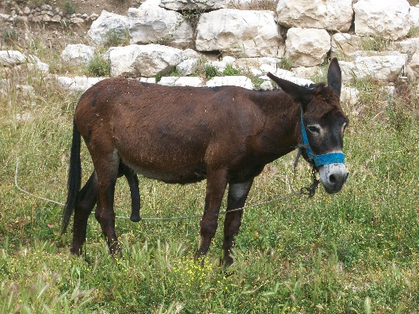
Second Coming
2 PETER
“this generation?”
Past
Present
Future
Preterits
Historicist
Futurist
Notes:
You get the donkey!

Slide 28
Second Coming
2 PETER
“this generation?”
Present
Present
Church Age
Historicist
Future Events
All these prophecies are revealing the entire course of Church history until the end.
Notes:
The present view or the Historicist view was a step in the right direction, but they too are shortsighted. Historicists say all of the prophecies concerning Christ’s second coming in Daniel, Ezekiel, Isaiah, Micah, Zechariah, etc. including Jesus in the Olivet Discourse and by John in the book of Revelation reveal or uncover the entire course Church history until the end of the age.
They taught that “this generation” applied to the present church age, the events and signs of the end of the age are presently being fulfilled today, even as I speak. Though they still believe in the physical return of Christ, the physical resurrection of the righteous and the wicked to face final judgment, and a future physical new creation of heaven and earth.
Historicist see the antichrist as a present feature in the world of our time, fulfilled in the papacy. They identified the popes as the antichrist, not as a single person, but a series antichrists. The Roman Church itself was the whore of Babylon in Rev. 17, the Beast of Revelation 13, and the little horn of Daniel 7. The Church was the persecuting apostasy. Martin Luther called the pope, the antichrist, and the pope return the favor and called Luther, the antichrist.
This differed from the Preterit’s position which says the antichrist has already come, which most identify as Nero, and the Futurist’s view which sees a single unknown individual to be unveiled in the future at the beginning of the tribulation. He is the “man of sin”, the one world ruler, along with the “false prophet” who most likely will be from the papacy. Their identity is unknown only to be revealed at the beginning and then forgot at the end of the tribulation.

Slide 29
Second Coming
2 PETER
“this generation?”
Present
Martin Luther
John Calvin
John Knox
Historicist
Almost All Protestant Reformers from the Reformation until the Great Disappointment (1844)
Notes:
The vast majority of the early reforms adapted a present fulfillment of the events spoken about in the Olivet Discourse and the book of Revelation, in contrast to Roman Catholic church’s view, that had dominated the middle ages.
The list includes: Martin Luther, John Calvin, Thomas Cranmer, John Knox, William Tyndale, Isaac Newton, Cotton Mather, Charles Wesley, Matthew Henry, Albert Barnes, and William Miller.
It was widely popularized in the16th century, via sermons, drama, books and broadside publications. Jesuit commentators developed two alternative approaches that would later become known as preterism and futurism. Luis de Alcazar developed a form of Preterism and Manuel Lacunza and Francisco Ribera developed a form of futurism.
The Historicist approach has been used in attempts to predict the end of the world. Charles Wesley predicted that the end of the world would occur in 1794 based on analysis of the Book of Revelation. Adam Clark proposed a date of 2015 for the end of papal power. The most famous was by the American, William Miller, whose followers became known as the “Millerites”, the movement was know as “Millerism”. He proposed a date of October 22, 1844 for the end of the world, based on Daniel 8:14 which it says the sanctuary will be trampled underfoot for 2300 days which he translated into 2300 years. He began with the decrees to rebuild Jerusalem in 456 BC + 2300 years = 1844 AD.
When the end of the world did not occur in 1844 it became know as the “Great Disappointment”, which resulted in widespread abandonment of historicism in eschatology among American Protestants and Evangelical churches. Some of Millerites eventually organized the Seventh-day Adventist Church which continues to maintain the historicist reading of prophetic passages. Another offshoot of the Millerites spawned the “Watch Tower Movement”, the “Jehovah Witness” who also maintain a historicist interpretation of the Bible.
Beginning to reemerge at about the same time in the middle of the 19th century from the nearly forget depths of church history was the futurist view of last things. Arising in Britain and Scotland, among the separatist, William Kelly, Darby and the Plymouth Brethren became the leading proponents of the futurists. After the grammatical, historical method of interpretation began to be applied to prophetic scripture, as opposed to the allegorical subjective method, futurism began it ascendency in popularity in Protestant Church around the world.

Slide 30


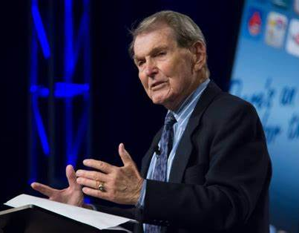
Second Coming
2 PETER
“this generation?”
Present
1948 - 1988
Historicist
Rapture Signs
Jack Van Impe
Tim LaHaye
Notes:
There is a hybrid or crossover view that became very popular after the establishment of nation of Israel in 1948. Many believe that the fullness of the Gentiles was over, the rapture, and the events surrounding Christ’s return would occur within “their present generation”, sometime between 1948 and 1988. The signs of the end of the age and of the signs Christ coming was near were inaugurated by the establishment of the nation of Israel in 1948.
The signs of the coming of the Lord were being fulfill before our very eyes—increasing wars and rumors of wars, famines and earthquakes, etc. are signs for us today that He’s coming soon. Even the proliferation of people receiving vision and dreams, miraculous miracle of healing, and men and women prophesying in ecstatic languages with the Charismatic Movement that began in 1960’s was a fulfillment of the prophet Joel. They insisted the coming of the Lord, the Rapture would occur within their generation. Someone wrote 88 reasons why the rapture would occur in 1988. Well, it didn't happen, because again they were “shortsighted”. There are no signs of the rapture, nor are the signs of the end of the age and His coming for today. They are for the future. If you chose door #2 they you get ZONKED!

Slide 31

Second Coming
2 PETER
“this generation?”
Past
Present
Future
Preterits
Historicist
Futurist
Notes:
You get the booby prize. Whaw, whaw, whaaaaaw.

Slide 32
Second Coming
2 PETER
“this generation?”
Future
Irenaeus (130- 202)
Polycarp
John the Apostle
Futurist
Papias (70-155)
Aristion and Elder John
Notes:
The Futurist views has been mocked, ridiculed, demeaned and said to be intellectually inferior by their opponents. It is said to be the pessimistic view of the future with its emphasis on the literal interpretation of the judgments. In the end it is in fact the most optimistic view available with its literal interpretation of the coming Millennial age and eternal state.
The futurist view goes back to a early church leader who guided and expanded the Christian community in South France, by the name of Irenaeus of Lyons, originally from Smyrna of Asia Minor. He had heard the preaching of Polycarp who in turn was said to have heard John the Apostle.
He believed there would be a future 3½ year reign of the antichrist when he sits in the temple of Jerusalem, terminated by the second coming of Christ, followed by the millennial reign of the righteous. He asserts that the 1000 year reign of Christ and the resurrections are actualities, not allegories, the time when the risen saints are described as ruling over the renewed earth during the millennium… He is grouped with other early church fathers as teaching premillennialism, Christ return to the earth before the millennium. He also believed that the saints would be translated before the Tribulation.
Few early Christians wrote about this aspect of eschatology during the first century of Christianity, but most of the available writings from the period reflect a millenarianist perspective (sometimes referred to as chiliasm). Bishop Papias of Hierapols (A.D. 70–155) speaks in favor of a pre-millennial position and Aristion and the elder John echoed his sentiments, including Justin Martyr, as did other first-hand disciples and secondary followers.
Premillennialism was the only view held by the early church fathers, before the church was Hellenized/Greekenized by the Alexandrian School of Theology beginning as early as the 4th century. The Futurist view was suppressed and ridiculed, declared inferior to the more superior new Greek Church Fathers with their allegorical interpretation. Futurist were banished, imprisoned and sometimes killed.

Slide 33
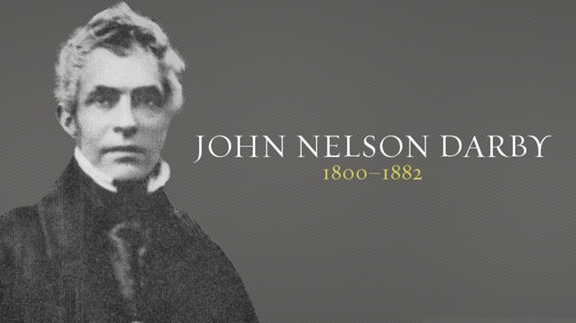
Second Coming
2 PETER
“this generation?”
Future
Reformation Comeback
Futurist
Many More to be Discovered
Notes:
It was not until the time of the Reformation that the futurist view began to make a comeback. It started when some of the reformers and separatist began to apply the historical, grammatical method of interpretation to all of scripture, including unfulfilled prophecy. This began a process of rediscovery of that allowed many to now totally rethink and reintroduce the futurist view, that had been previously held in the 2nd and 3rd centuries.
It wasn’t until the 1830s that pre-tribulation rapture was popularized by John Nelson Darby and the Plymouth Brethren. It was further popularized in the US in the early 20th century by the widely circulation of the Scofield Reference Bible. Darby was no slouch. He produced translations of the Bible in German, French, Dutch, and English based on the Hebrew and Greek texts. He was a Anglo-Irish Bible teacher. He is considered to be the father of modern Dispensationalism and Futurism. Though he was not the only person to originated this truth.
Tommy Ice (Dallas Grad) who heads the Pretribulation Research Institute says that there are several individuals familiar with the ancient languages (Latin, Greek and so forth) who have discovered at least 15 others who wrote from a Futurist perspective of some sort. They are supposed to release there findings soon in an upcoming book.

Slide 34
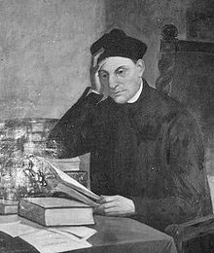
Second Coming
2 PETER
“this generation?”
Future
Manuel Del Lacunza
Futurist
Jesuit Priest
“Ben Ezra”
1810
Notes:
Some twenty years before Darby there was another Jesuit priest by the name of Manuel Del Lacunza who also wanted to find an alternative view of the Protestants, to deflect criticism that the Popes were the antichrist. After the king of Spain had expelled all Jesuits from Spain, Lacunza was sent into exile eventually ending up in Chili. At some point, he began a intensive study of the Church Fathers and of Biblical prophecy and wrote his main work in a pseudonym piece called Juan Josafat Ben Erza. His book was rejected and banned by the church from which he belonged. It was even placed on Pope Leo XII Index of Prohibited Books, for it contradicted the Roman Catholics doctrine of Amillenialism.
One of the most interest things I found concerning his Futurist findings was that Lacunza concluded that the biblical expressions “end of the age” and “end of the world” refer to two different times. He understood the “end of the age” or “day of the Lord” as merely the end of a phase of human history that would be closed by the coming of Christ and the beginning of His Kingdom on earth. At this time the living would be judged and the Jews converted, after which a new society would be established for a thousand year reign of justice and peace”. (Wikipedia)

Slide 35
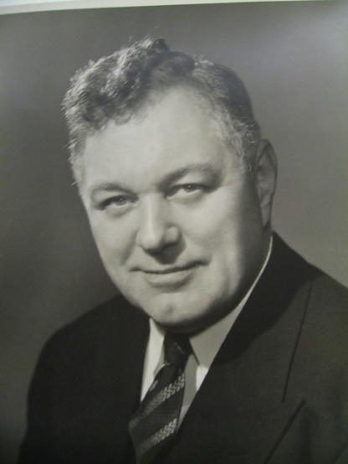
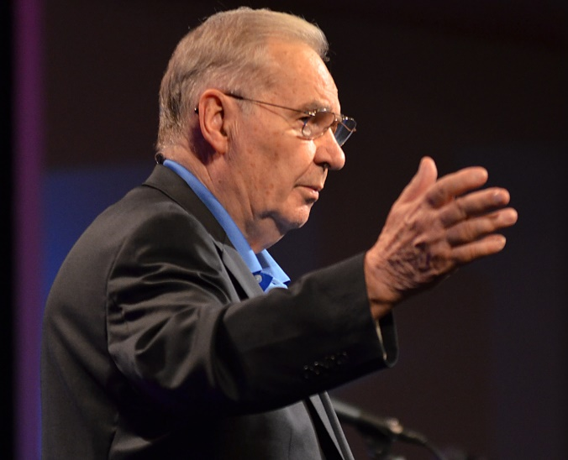

Second Coming
2 PETER
“this generation?”
Future
Long List of Futurist Proponents Today
Futurist
Notes:
There is a long list of theologians and proponents today, the most notable are Donald Barnhouse, Martin De Haan, Norman Geisler, Harry Ironside, Walter Kaiser, John MacArthur, J. Vernon McGee, Henry Morris, Warren Wiersbe…

Slide 36
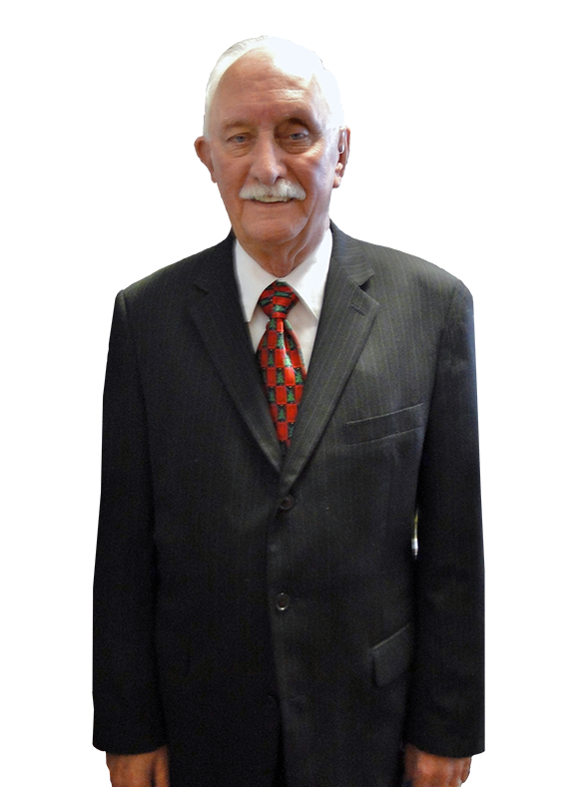

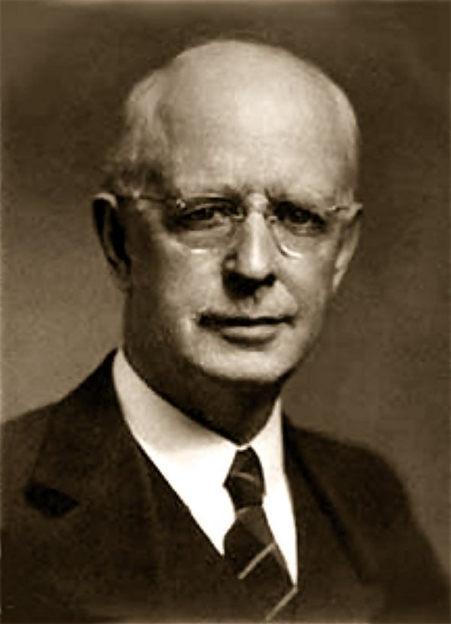
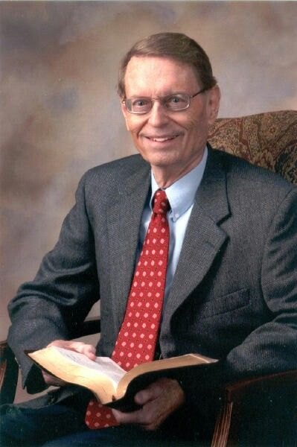
Second Coming
2 PETER
“this generation?”
Future
Long List of Futurist Proponents Today
Futurist
Notes:
Dallas Seminary theologians and professors, the founder Lewis Sperry Chafer, Dwight Pentecost Charles Ryrie, John Walvoord, Hal Lindsey, and the most famous of them all the one and only Dr. C. Norman Sellers.

Slide 37
Second Coming
2 PETER
“this generation?”
Future
Long List of Material Available for Study
Futurist
TLBC Doctrinal Statement
“Future Things”
NBC Theology IV

Slide 38
Second Coming
2 PETER
“this generation?”
Future
Long List of Material Available for Study
Futurist
nationalbiblecollege.com
freegracegospel.info

Slide 39

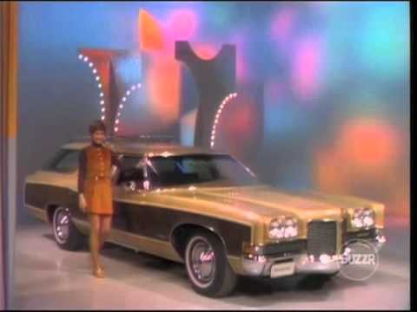
Second Coming
2 PETER
“this generation?”
Past
Present
Future
Preterits
Historicist
Futurist

Slide 40
Second Coming
2 PETER
“this generation?”
“Therefore, brethren, be even more diligent to make your call and election sure, for if you do these things you will never stumble; for so an entrance will be supplied to you abundantly into the everlasting kingdom of our Lord and Savior Jesus Christ.” (2 Peter 1:10-11)
Notes:
What do you really gain for making the right choice? What do you really lose for making the wrong choice? The answer is found in 2 Peter 1:10-11.

Slide 41
Second Coming
2 PETER
“this generation?”
Loser
Winner
The Loss of the Joy of Serving Christ
The Privilege of Ruling with Christ
An Abundant Introduction into His Kingdom
Loss of Reward, Praise and Honor

Slide 42
Second Coming
2 PETER
Conclusion

Slide 43
Second Coming
2 PETER
“For many deceivers have gone out into the world who do not confess Jesus Christ as coming in the flesh. This is a deceiver and an antichrist. Look to yourselves, that we do not lose those things we worked for, but that we may receive a full reward.” (2 John 7-8)

